Slide 1
四级作文
写作要求 评分标准
文章的结构 语言要求

Slide 2
一、四级作文的写作要求
作文的命题形式更趋多样化，如应用文增多，文体的综合性加大。所以，描述现象、分析原因、阐明个人看法等 仍是四级考试写作部分主要考查的重点。
英语写作重点应在 说明文、议论文和应用文上。
内容大多紧贴社会热点、学生生活与学习等。

Slide 3
写作题型：
1. 命题作文：按照题目指定的内容、范围、提示等确定中心思想。如:
1) 给题目、给中心句(eg. My Views on Campus Security)；
2) 只给题目，不给提纲或提示(eg. A Course That Has Impressed Me Most in College <2014年12月>)；
3) 只给提示或提纲 (eg. Write an essay commenting on the saying: “Never go out to see what happens; go out there to make things happen. <2015年12月>)

Slide 4
2. 情景作文：通过所给的情景（时间、地点、人物等），确定文章主题内容。
3. 图表写作：依据所给的图、表格写作。

Slide 5
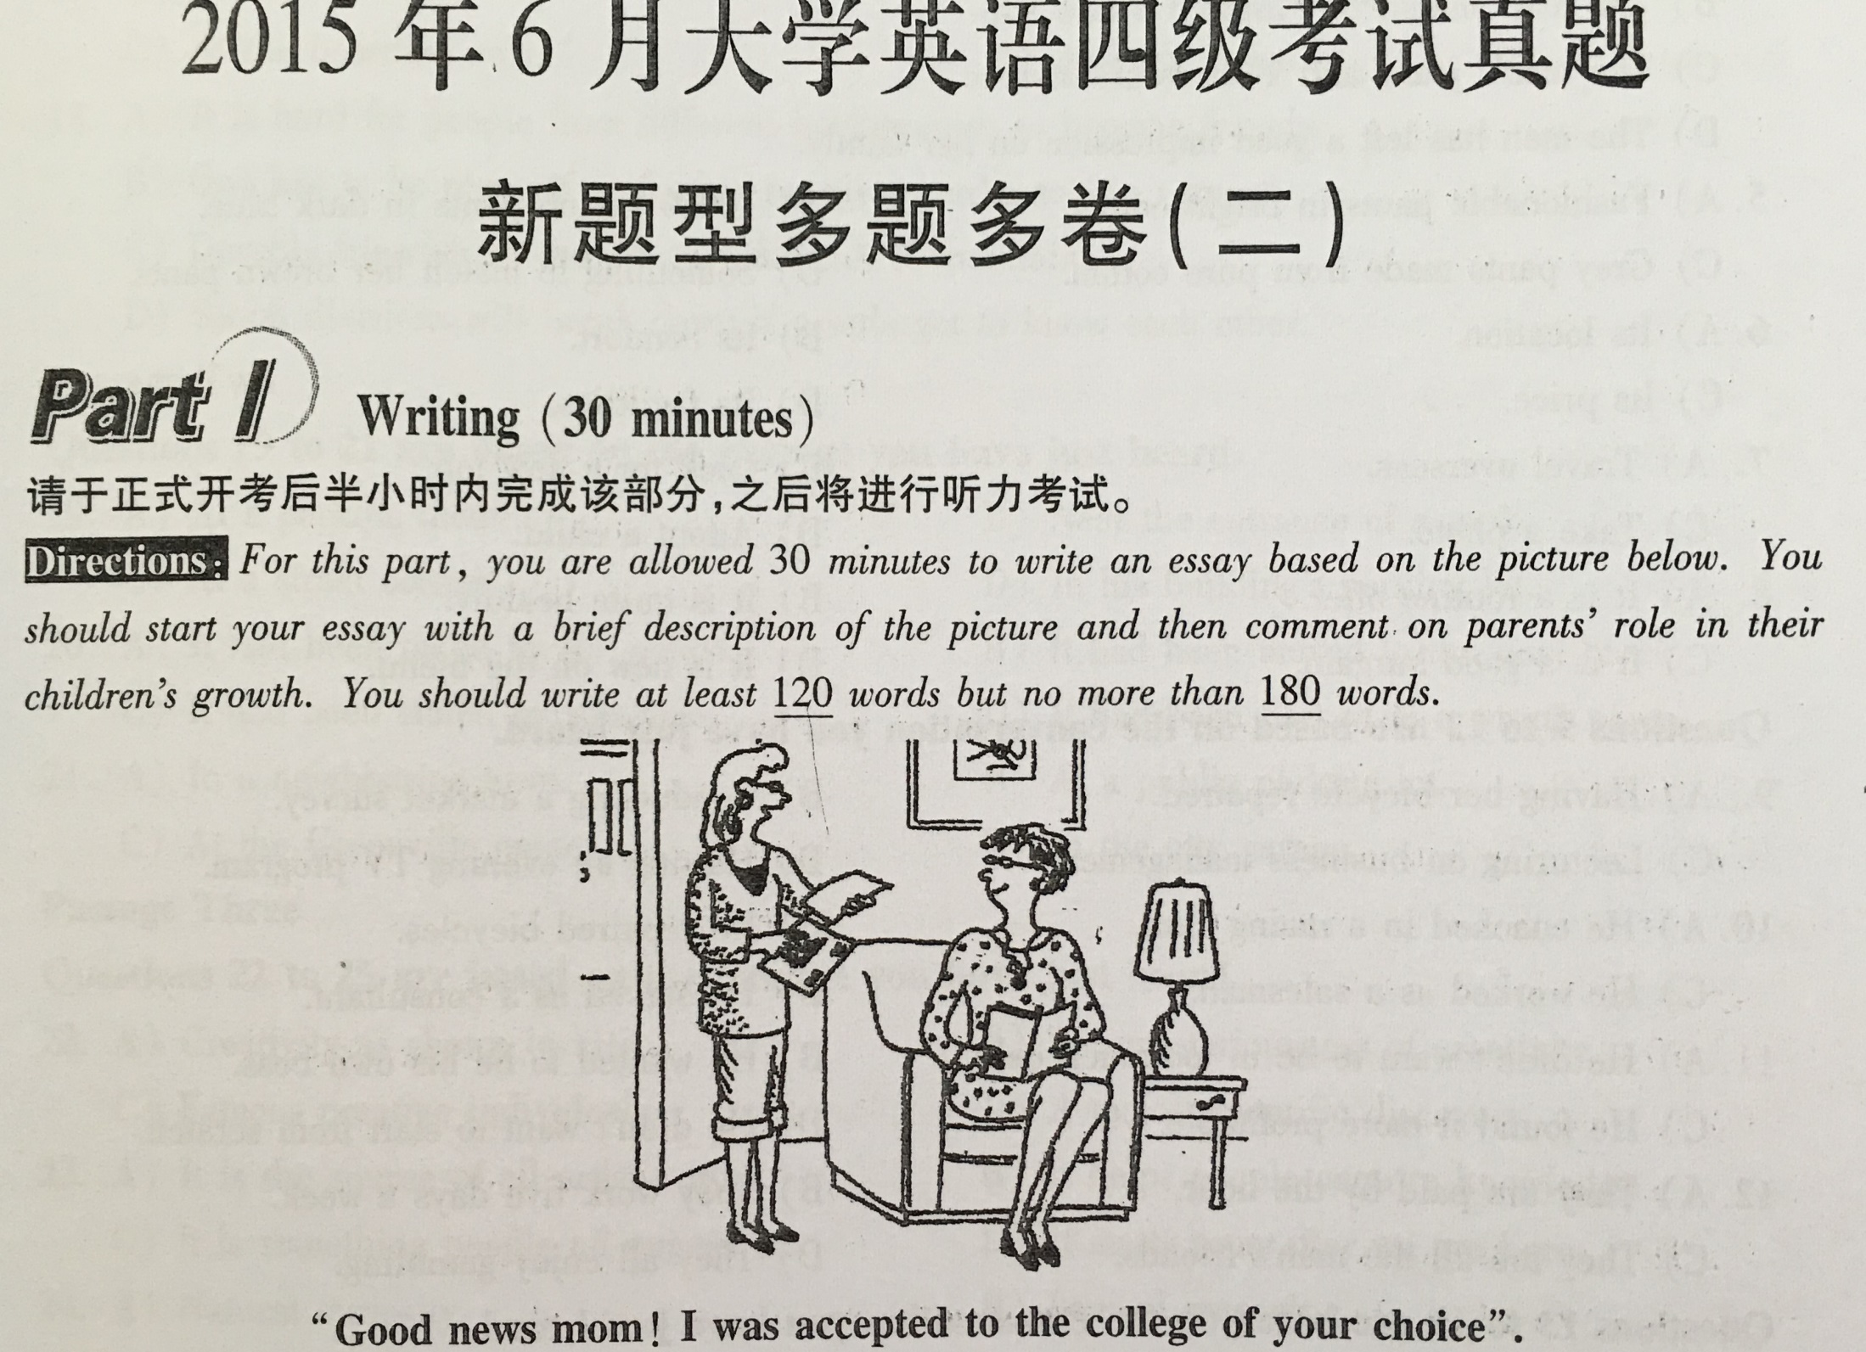

Slide 6
二、评分原则和标准：
1.评分原则：总体评分原则（Global Scoring）
1）内容：
作文是否体现主题思想：统一，无不相关细节内容
2）结构：
组织结构是否合理：条理清楚：连贯、和谐 - 注意衔接语的使用
3）语言：
语法文字是否有重大错误：准确，减少语法错误，符合英语的表达习惯，避免汉语式英语
卷面布局是否整洁

Slide 7
2. 评分标准
2分- 条理不清，思路紊乱，语言支离破碎或大部分句子均有错误,但多数为严重错误；
5分- 基本切题。表达思想不清楚，连贯性差。有较多的严重语言错误；
8分- 基本切题。有些地方表达思想不过清楚，文字勉强连贯；语言错误相当多，其中有一些是严重错误；
11分- 切题。表达思想清楚，文字连贯，用词准确，但有少量语言错误；
14分- 切题。表达思想清楚，文字通顺，用词适切，连贯性较好。基本上无语言错误，仅有个别小错误。

Slide 8
篇幅：120-180字
达不到字数要求的，要酌情扣1-5分； 81-89 扣1分，
71-80扣2分，
61-70扣3分，
50-60扣4分，
50字以下，至多给5分；
布局：三段式
只写一段为0-4分，只写两段0-9分；

Slide 9
写作顺序
审题
列提纲
草稿
修改

Slide 10
篇章
篇章的组成
Introduction ---- Body ---- Conclusion
由于四级作文对布局的要求是三段式，同学们在写作中就应该注意这种三段式结构:
第一段：中引出话题，从而提出主题;
第二段：采用举例、列举或比较的方式论证或说明自己的观点；
第三段：结论处或重述主题、或归纳总结照应首段，或提出问题的解决方式等。

Slide 11
开头段的写作

Slide 12
谚语法
由于谚语一般已经被大家所接受，用谚语提出自己的观点也容易被读者所接受。
As the saying goes, "Money makes the mare go", but there are many things we can't buy with money, such as time and true love. …

Slide 13
引语法
1. "Just as eating without liking harms the health, learning without interest harms the memory and can't be retained." From Vinci's words we can see how important it is to motivate the students in language learning.
2. “If you miss one day of practice, you notice the difference.” …. (U3,B4)

Slide 14
定义法
定义法是通过对文章中的关键词做一些简单或正面或反面的解释，限定其范围，这样比较有利于引出主题。
1. "Practice makes perfect" is an old saying. It tells us that it does not matter if we are clumsy at doing something. As long as we keep on trying and practicing, we will do a good job in the end.
2. Globalization refers to a trend in which people, companies and governments of different nations interact and integrate with each other across national borders. Globalized
activities are actually quite common
nowadays. But is globalization welcome?

Slide 15
提问法
通过提问一个或一连串的问题，可以激发读者的兴趣，从而引出主题。
Do you remember the four-minute mile? Athletes have been …. ( U3,B4)

Slide 16
概括法
概括法指先概括性描述文章内容所涉及的现状，然后引出主题。
In recent years, with the development of science and technology, the Internet has come into more and more homes and is playing a more and more important role in our work and daily life. It has become a must to us, but at the same time, Internet has also brought about a lot of problems.

Slide 17
对立法
对立法是指文章一开头列举人们对所讨论的问题所持的不同观点然后提出自己的观点。
Suppose you were offered two jobs: one is highly-paid but rather demanding; the other is less demanding, but poorly-paid, which would you prefer? …

Slide 18
调查法
为了得到读者的认可，文章的开始可以引出调查数据等，借以提出主题。
According to a recent survey by China Daily, about 15% percent of college graduates have difficulty finding a job after their graduation, and the number seems to be increasing.

Slide 19
结论段的写作

Slide 20
结论一般采用归纳概括、主题重述或提建议等方式。
常见的方式有：
1） 重述或总结主题
重述主题指于结论处以另外一种表达方式重申主题，与首段照应。
Families offer us warmth and care. Friends give us strength and horizon. They both help us understand the world as it is. Both of them are the dearest parts in our life.

Slide 21
2） 提出建议
Since postcards do us more harm and good, since we have many other ways to convey our feelings and promote our friendship, I hope everyone will take actions now to stop using postcards.
3） 概括总结
As we can see from the above, living in the suburb we can stay away from pollution, lead an easy leisure time, and needn't invest too much money, so I prefer living in the suburb to living in the city.

Slide 22
4） 引用名人名言
In particular, I enjoy what Francis Bacon said "Studies serve for delight, for ornament and for ability."
5) 综合法
结论段也可以是多种方法的综合。一般说来，总结加建议的比较多。

Slide 23
尾段示例
如"网络"的结论段可以如下所示：
As we all know, the next century will become one of the Internet. It will become more and more important in both our daily life and our work. So I suggest that schoolchildren should start using the Internet.
So I think schoolchildren not only can start using the Internet, but also should start using it They are sure to benefit a lot from the internet.
Internet can help our children know the world, get useful information and enrich their knowledge. So I think schoolchildren can start using the Internet.
In a word (In conclusion/ In summary/ To sum up / In short), the Internet is playing a more and more important role in our life and it is helpful for children's growth both physically and mentally. It is better for them to start using the Internet as early as possible.

Slide 24
四级英语主体段落的写作模式

Slide 25
段落的组成
Topic Sentence (TS);
Supporting Sentences (SS);
Conclusion Sentence (CS)
四级作文的段落一般由中心句、支撑句、结尾句构成。支撑句须按一定的逻辑关系阐述事实、细节、证据、数据等来说明/ 支撑中心句。偶尔辅以结尾句进行总结、重述等。

Slide 26
段落扩展模式

Slide 27
比较和对照
就比较对照而言，段落格式可采用逐点比较(point-by-point method)的方式，也可采用块状比较(block method)的方式。
逐点比较的格式是: A1 ---- B1；A2 --- B2 ；A3 --- B3
块状比较的格式是：A1，2，3 ---- B1，2， 3
常用语汇：like, unlike, while, at the same time, similar to, accordingly, both, show a degree of similarity, similarly, the same as, and… too, in the same way, in like manner,
likewise etc.

Slide 28
举例法
列举事实或举出实例来说明中心思想, 是简单易行、具有说服力的写作方法。
Communicating with other people by telephone is very convenient, especially when you have something urgent. For example, if one of your family members is seriously ill right now, and you don’t know how to deal with it and where to find a doctor, what can you do? A telephone is the answer. Dial 120 and you will get services from the hospital very soon.
列举时常用for example, for instance, such
as, like, as proof, thus, take…for
example, to illustrate 等词语.

Slide 29
因果关系
在段落一开头，就用主题句点明其因果关系，然后选用有关材料，客观的罗列某些原因或结果，以证阐述的中心思想。
Growing numbers of well-to-do Americans are making the decision to move abroad. They find it impossible in America to walk the streets at night without fear of being raped, mugged, or murdered, nor do they see a way to escape the poisonous air of the cities. They maintain that even American food has become increasingly dangerous to eat. Last but not least, they insist that they are sick of the pace of American life, a pace that leaves no time for relaxation or pleasure.
因果关系常用语汇: because of, so, owing to, thanks to,
thus, as a result of, hence, for this reason,
consequently, is caused by, lead to, result in/ from etc.

Slide 30
列举 /分类法: 一般是在主题句之后，依次罗列段落指示词所表达的几个部分或几个方面。然后，选用丰富的事例对所罗列的各个部分或各个方面进行具体地说明或解释。
As far as political views are concerned, people fall into three categories. First are the conservative people. Conservatives are opposed to sudden or great changes. Second are the liberal people. These people are in favor of progress and reform. But their opinions often seem to idealistic. The third type is the moderate people. The moderates keep everything within reasonable litmus. They are more practical in this hard world. In my opinion, most people seem to belong to this group.
分类时常用：most of all， next，moreover， in
addition，besides，furthermore，to begin with
，to start with，first of all，first，second …

Slide 31
转承语的使用

Slide 32
根据不同的段落要求，选择适当的转承语
1) 比较对照
比较：like A, B …
Just as A, B …
A, similarly/correspondingly, likewise/in the same way, B …
对照：Unlike/ Contrary to/ As opposed to A, B …
A , however/on the other hand/in contrast, B ..
A …, B, however/on the other hand/in contrast, …

Slide 33
2)列举
First/ Second (Next) / Third (Then)/ Last (Finally), …
The fist/ The second/ The third/ The last (The final)
Firstly/Secondly/Thirdly/Last (Finally)
One/Another/Still another/The last
The most essential/most important/primary/chief is …
3) 因果
as a result, consequently, therefore, hence, so, because of this, for these reasons, due to the fact that

Slide 34
起承转合常用语
1. "起"的常用语
When asked about/ When it comes to/ Faced with …, some people
claim/think/argue/believe that …, but/while others …(differently)
Nowadays there is much/general discussion as to ….
With the development/improvement/growth of …,
Now, it is commonly/widely/increasingly believed/thought/held/acknowledged that …,
According to a recent survey/ investigation/ poll, …
Have you ever thought/ wondered …?
Suppose …
As the saying goes, …

Slide 35
2. "承"的常用语
Those who hold ….
It is true that …
To be sure ..
First/Firstly …
The main/leading/underlying/root/ primary/chief/essential reason for ….
"承接上文"的方式与文章的段落结构有关，比较的与列举的不同，与举例的也不同。同学们应根据具体的情况选择适当的承接语。

Slide 36
3. “转”的常用语
It sounds like a good (attractive) idea (suggestion), but they fail to understand (see, notice) ….
There is probably an element of truth in the arguments (ideas), but they ignore a more important (basic) fact …
Closer examination (analysis), however, suggests (shows) that this argument (claim, idea) may not be supported by the following evidence (facts, examples, statistics).
Close (careful) examination (analysis) of these arguments (ideas, suggestions), however, would reveal (suggest, prove) how flimsy (不足信的，不严密的) (fallacious（靠不住的）, groundless（没有根据的）) they are.
However logical (sound, forcible(有说服力)) these arguments may be, they don't make sense (only skim the surface of the problem) when … is viewed the other way (taken into consideration).

Slide 37
As opposed to (Contrary to) the widely (commonly, generally) held idea (belief, view), new studies (facts) challenge (fail to justify) the opinion (view).
Good/Superior/Wonderful as …., it has its own disadvantages/ it brings its own problems.
They may be right about …, but they seem to neglect /fail to mention/take into account …
In all the discussion and debate over …, one important/basic fact is ignored/ overlooked/ neglected.
It is true that/ Admittedly, but it is unlikely/doesn't follow/doesn't mean that …
There is an element of truth in these arguments/statements, but they ignore a deeper and more basic/essential/important fact/factor …
In many cases, however, …
As far as .. is concerned, …

Slide 38
4. "合"的常用语
Experience/Evidence/All the facts suggest/show/demonstrate/ indicate that …
From what has been discussed above/Taking into account all these factors, we may safely draw/reach/come to/arrive/ the conclusion that…
In conclusion/To sum up/In summary/In short/To conclude ….
It is important/necessary/essential that effective/proper/powerful actions/measure/remedies should be taken to …

